Slide 1
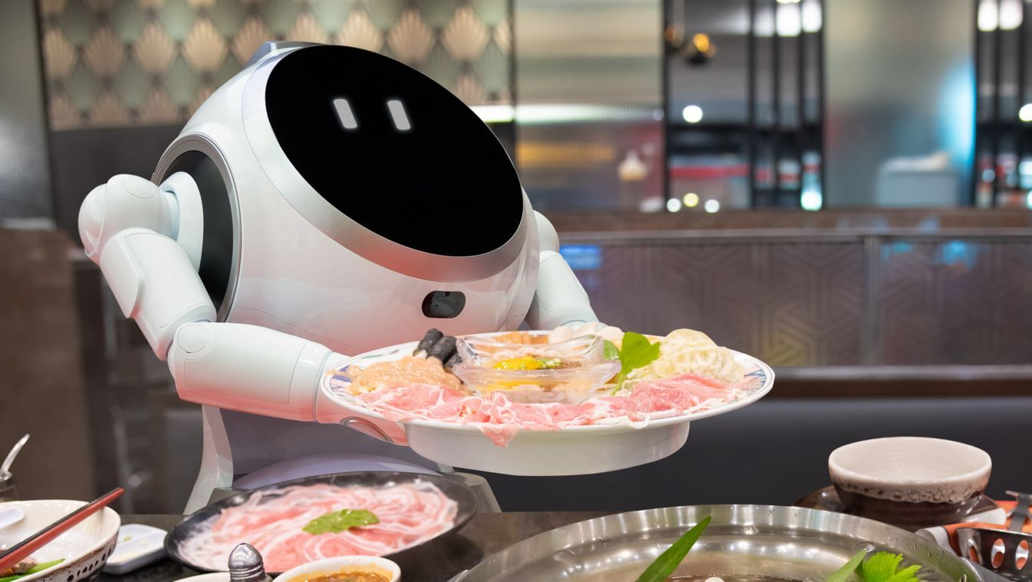
Café Walley
Robot-run Café
Author: Kamil Kanafin. Email: Kanafin.kamil@gmail.com

Slide 2

Why is it profitable?

Slide 3
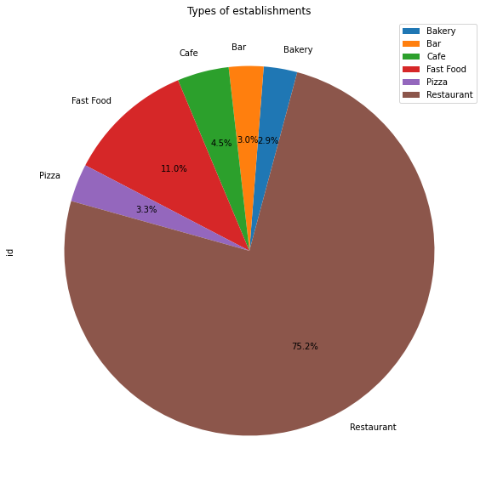
Most popular types of establishments
According to the plotted graphs, it can be seen that the largest part is occupied by restaurants (75.2%) among the types of establishments.
In second place are establishments such as Fast Food (11.0%).
And the third most popular is the cafe (4.5%)

Slide 4
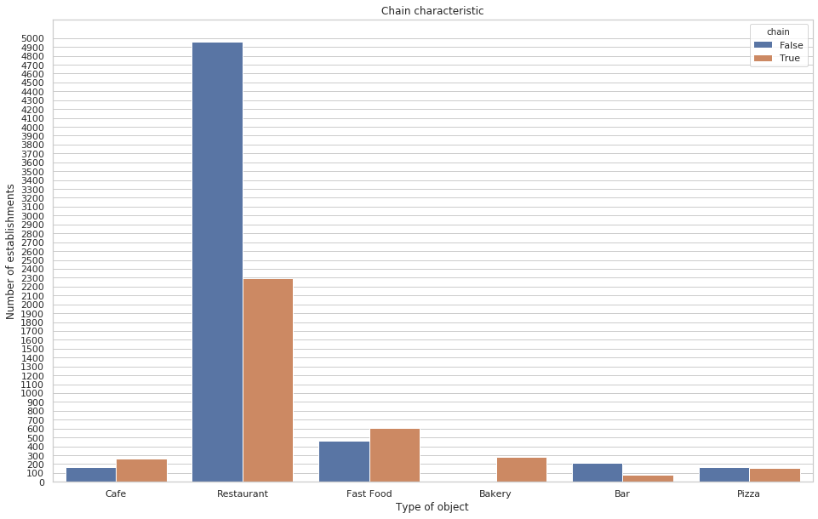
Do we need a chain?

Slide 5
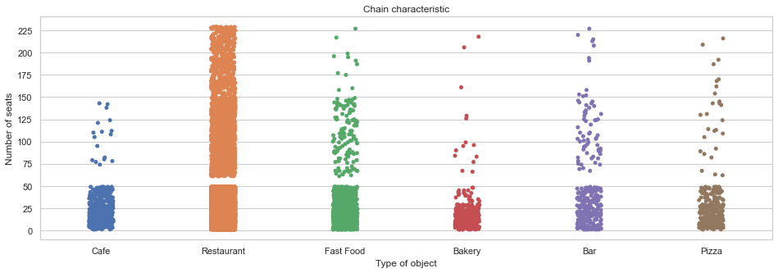
Small or a lot of seats?

Slide 6
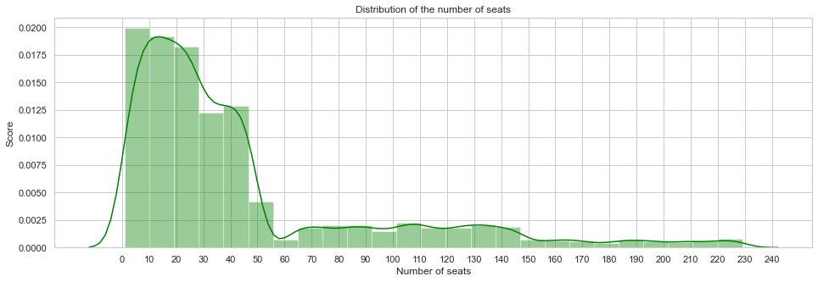

Slide 7
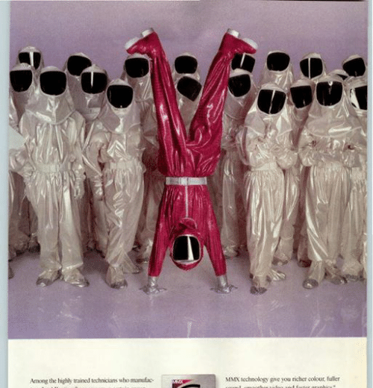
Uniqueness?
For an establishment and place like LA, the format of a restaurant that has no chain is definitely suitable.
If you still limit the number of seating places from 10 to 20 and if you can arouse the interest of guests, then people will definitely come to you. The location matters, of course.
It will also be necessary to analyze the type of client for whom this institution will be designed.
But the main uniqueness of this restaurants will be the uniqueness of customer service - robots.

Slide 8

Q&A

